Slide 1




FORESIGHT STUDY: UNLOCK THE POTENTIAL OF A NATIONAL BRAND/NGO PARTNERSHIP
2025-2026
Vinayak SINGH
12th May 2026

Slide 2

Table of content
1
3
INTRODUCTION
EXECUTIVE RECOMMENDATION
PARTNERSHIP CONTEXT
SCQA
PILLAR 1
KEY TAKEAWAY
PILLAR 2
2
4
BENCHMARKING
CONCLUSION
MATURITY GAP
IMPLEMENTATION PLAN
SUCCESS CRITERIA
EVOLUTION OF SUCCESSFUL PARTNERSHIP
McCain × Lazare × CNPB Consulting Project 2026

Slide 3
McCain X Lazare
€300K
Donated
3-year
Partnership
Partnership Context
The partnership successfully supported Lazare’s social mission but remained primarily donation-driven and disconnected from McCain’s commercial ecosystem.
Main Initiatives
Key Challenges
Financial donations
Events & chef collaborations
Employee volunteering
Digital communication
On-pack visibility
McCain’s “Born to Share” positioning was not strongly associated with Lazare
Emotional brand equity impact remained limited
Clear KPI or long-term activation framework missing
Global leader in frozen potato products
Presence in 160+ countries
~42% frozen fries market share in France
Brand platform: “Born to Share”
Strategic Ambition
French NGO founded in 2010
Shared housing model
Homeless individuals + young professionals living together
Focus: Dignity, inclusion, social reintegration
Transactional
CSR donation model
Shared Value Partnership
McCain × Lazare × CNPB Consulting Project 2026

Slide 4

S
Situation
Complication
C
Partnership primarily driven by donations and isolated activations
Brand visibility and emotional engagement remained underleveraged
3-year partnership
Strong alignment:
“Born to Share” × social reintegration
Existing initiatives:
donations, volunteering,
awareness campaigns
SCQA
Limited operational integration and KPI formalization
From Transactional CSR
to Shared Value Partnership
Reworking the McCain × Lazare
partnership through retail integration
and measurable impact.
Strategic benchmark & trend analysis
How can McCain transform the Lazare partnership from a
Partnership success framework evaluation
transactional CSR donation model into a scalable retail-driven shared value partnership?
Retail moodboard & activation concepts
Integrated communication & storytelling framework
Q
Questions
Approach
A
McCain × Lazare × CNPB Consulting Project 2026

Slide 5
Can success be measured and governed effectively ?
Partnership performance is currently difficult to track and scale
01
Leading partnerships rely on clear KPIs, governance, and recurring impact reviews
McCain × Lazare lacks a structured measurement framework
Does this partnership follow the trends of a successful partnership ?
02
McCain × Lazare shows potential, but remains under-integrated
Strong CSR partnerships move beyond one-off donations
Retail integration and emotional storytelling drive engagement
Does Mcain have the levers to amplify Social impact and Brand visibility ?
03
High visibility potential, limited execution maturity
McCain benefits from strong retail reach, storytelling assets, and brand-NGO alignment
These levers are not yet fully activated
Does Mcain have the partnership to scale through the retail ecosystem ?
04
Strong scale opportunity, but no clear rollout model yet
Retailers increasingly support measurable cause-led activations
Scaling requires simple, repeatable retail mechanics
Key Takeaways
Conclusion
05
McCain × Lazare has strong strategic fit, but underperforms due to weak KPI governance, limited operational integration, and lack of a scalable retail model.
McCain × Lazare × CNPB Consulting Project 2026

Slide 6
McCain × Lazare
Inside a Retail Environment
Use of foresight tools and
benchmarking
McCain × Lazare × CNPB Consulting Project 2026

Slide 7
Methodological
Foundations
To Future-proof the McCain-Lazare partnership, we deployed a rigorous foresight methodology to anticipate the future of corporate-NGO collaborations.
PESTEL Horizon Scan: Systematic detection of macro-environmental shifts and emerging weak signals.
Global Intelligence Triangulation: Data sourced from the C&E Advisory Barometer (2024-2025), OECD Development Finance, and World Economic Forum.
Academic Validation: Grounded in peer-reviewed academic literature published between 2019 and 2026.
TRANSACTIONAL CHARITY ⟶ STRATEGIC CO-CREATION
57%
92%
of corporates globally now cite "deeper problem solving" as their primary reason for partnering with NGOs.
report that non-cash competencies offer more value and strategic impact than financial transfers alone.
McCain × Lazare × CNPB Consulting Project 2026

Slide 8
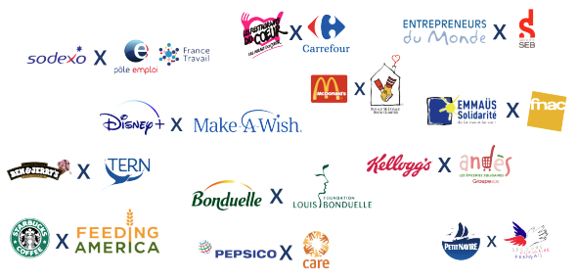
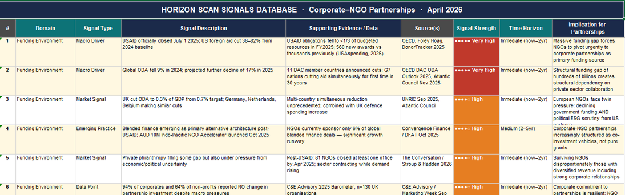
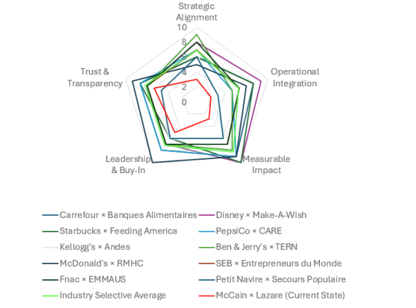
BENCHMARKING AGAINST SIMILAR SUCCESSFUL PARTNERSHIPS ACROSS THE GLOBE
STEPS FOR BENCHMARKING
To benchmark the five criteria, each of the five team members independently reviewed a minimum of four globally recognised corporate–NGO partnerships, assessing how each defined and communicated success. This produced a pool of sixteen partnership reviews across the group. The team then convened in a calibration session in which each member's independent scores and interpretations were presented, cross-examined, and debated until a consensus position was reached. This process ensured that the final scores reflected collective analytical judgement rather than any single perspective
McCain × Lazare × CNPB Consulting Project 2026

Slide 9
The McCain-Lazare Maturity Gap
The McCain-Lazare Maturity Gap
Selective Industry Avg.
35.6/50
McCain X Lazare
(Current)
18.8/50
Current State
Invisible to consumer, siloed CSR budget
The Auchan Mandate
Must become a commercial & Category driver
-5.5 pts
Measurable Impact
Retailers require commercial ROI. We currently have no brand equity KPIs or public social impact metrics to justify Auchan's shelf space.
-3.9 pts
Operational Integration
Partnership exists only as isolated campaign events. Lacks a permanent, hard-wired routine in the frozen food aisle.
-3.9 pts
Strategic Alignment
Lazare's cause-first focus has suppressed McCain's brand. The "Born to Share" link to Lazare's table remains invisible.
-2.2 pts
Leadership Buy-In
Historically delegated to CSR. Must be reframed as a commercial growth and retail innovation priority.
-1.3 pts
Transparency
Financial donations lack clear disclosure mechanics on-pack, risking "greenwashing" accusations from modern shoppers.
McCain × Lazare × CNPB Consulting Project 2026

Slide 10


SUCCESS CRITERIA FOR A HIGH-PARTNERSHIP BRAND X NGO PARTNERSHIP
____________________________________________________________________________________________________
🧭 Strategic Alignment
⚙️ Operational Integration
🔍 Trust & Transparency
📊 Measurable Impact (KPIs)
👥 Leadership & Buy-In
Partnership driven mainly by donations, not shared value
No operational roadmap for retail execution
Unclear communication rights and reporting structure
No agreed success metrics or retail performance tracking
Partnership treated as a peripheral CSR initiative
Strong values alignment, but weak business integration
Retail ambition exists, but execution feasibility remains unclear
Informal trust exists, but governance remains undefined
Partial KPI measurement focused on either brand or NGO impact
Support exists, but ownership remains siloed
Clear shared purpose embedded into brand and activation strategy
Partnership embedded into scalable retail activation mechanics
Transparent reporting and clearly defined communication rules
Shared KPI framework across brand, retail, and social impact
Visible cross-functional and executive sponsorship
_______________________________________________
Purpose fatigue & CSR washing perception if the partnership feels symbolic rather than structurally embedded
Activation failure due to operational complexity (Delays and Sunk costs due rom late discovery of packaging/legal limitations
Reputational tension between partners from conflicting visibility expectations
Inability to justify continuation or scaling without agreed success metrics
High vulnerability during budget cycles if not positioned as strategic
____________________________________________________________________________________________________
Ben & Jerry’s × TERN demonstrates strong strategic alignment by embedding social activism directly into brand identity and consumer communication
Disney × Make-A-Wish embeds the partnership into permanent operational routines supported by dedicated infrastructure and measurable impact tracking
Starbucks × Feeding America builds stakeholder trust through transparent impact reporting and clearly communicated contribution mechanisms
Starbucks × Feeding America demonstrates KPI-driven partnership governance through store-level impact tracking and transparent public reporting.
McDonald’s × RMHC demonstrates long-term partnership continuity through strong executive sponsorship and institutional integration
Establish a unified McCain × Lazare narrative with formalized communication rights across packaging, retail, and digital touchpoints
Build a recurring in-store activation model with Auchan through branded shelf presence, QR storytelling, and integrated donation mechanics
Implement transparent donation reporting with on-pack disclosures, live impact dashboards, and annual co-branded impact reports.
Implement a shared KPI framework covering social impact, brand equity, and retail performance before retailer rollout discussions
Position McCain × Lazare as a strategic brand platform with cross-functional ownership and visible senior leadership support
McCain × Lazare × CNPB Consulting Project 2026

Slide 11
EVOLUTION OF SUCCESSFUL PARTNERSHIPS
YEAR 1-2
YEAR 3-4
YEAR 5-6
SET-UP PHASE
INTEGRATION PHASE
SCALING PHASE
CHARACTERISTICS
CHARACTERISTICS
CHARACTERISTICS
Basic monetary donations; low-complexity support (events, volunteer days).
Brand evaluates values alignment with NGO.
Pilot activations: on-pack visibility, small PR pushes, standalone campaigns.
Donations evolve into structured programs (training, skills volunteering).
Joint narrative creation (emotion-building campaigns).
Early retailer involvement: POS visibility, pilot cause bundling.
Multi-stakeholder model: Brand × NGO × Retailer × Community.
Commercial mechanics added: (Cause-related SKUs ,% of sales donations, Co-funded promotions, Customer engagement drives)
NGO storytelling integrated across brand channels (TV, digital, CRM).
KPIs
KPIs
KPIs
Awareness baseline of partnership.
Early NGO reach uplift (volunteers, funds).
Qualitative brand lift (purpose fit).
Reach & participation.
Improvements in emotional brand equity.
NGO capacity growth (volunteer hours, program delivery).
Revenue from cause-related products.
Retail sell-out uplift during campaigns.
National visibility & media value.
McCain × Lazare × CNPB Consulting Project 2026

Slide 12
EVOLUTION OF SUCCESSFUL PARTNERSHIPS
YEAR 7-8
YEAR 9-10
SHARED VALUE PHASE
MATURITY PHASE
CHARACTERISTICS
CHARACTERISTICS
Institutionalised and self-sustaining partnership model.
Long-term funds, foundations, or permanent programs created.
Scalable model replicated across markets.
NGO gains stable funding; brand becomes category leader in purpose.
Partnership becomes long-term brand platform.
Joint ownership of impact programs (multi-city scale).
NGO built into ESG reporting and brand purpose.
KPIs
KPIs
Strong brand equity lift vs. competitors.
Measurable social outcomes (reintegration, redistribution, education).
Retail KPIs: traffic, loyalty, halo effect.
Multi-year social impact metrics (lives improved, CO₂ reduced, food redistributed).
Brand leadership in purpose & trust metrics.
Employer branding uplift (talent attraction/retention).
Program ROI: SROI, earned media, sales uplift.
McCain × Lazare × CNPB Consulting Project 2026

Slide 13
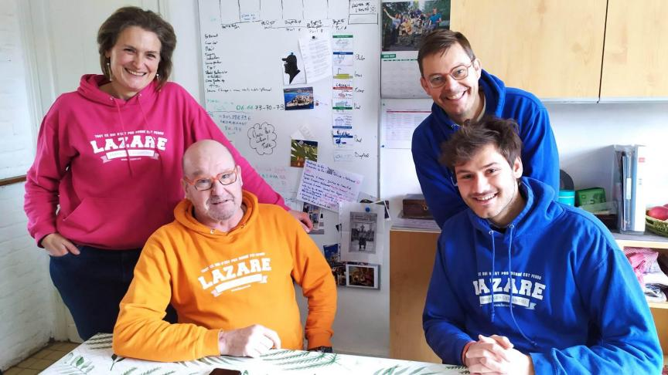
The new approach
Invisible Impact: The current 3-year partnership relies strictly on financial donations, offering zero brand visibility for McCain among consumers.
Communication Gap: Lazare focuses purely on its cause, masking the connection to McCain's "Born to Share" values.
The Opportunity: Transition from isolated charitable events to a structural, commercial partnership involving retailer Auchan.
The Goal: Create a highly visible, permanent CSR halo that benefits Lazare financially while building McCain's brand equity in-store.
McCain × Lazare × CNPB Consulting Project 2026

Slide 14
McCain × Lazare
Inside a Retail Environment
Low-Friction Engagement (Mass Market Reach)
McCain × Lazare × CNPB Consulting Project 2026

Slide 15
MASS MARKET REACH
Product-Sharing & Packaging (“Produit-partage”)
What it is:
Visibility KPIs
Create a limited-edition co-branded McCain × Lazare pack or sleeve.
Launch seasonal or permanent McCain × Lazare products. (new potatoe shape)
Clearly display a fixed donation per purchase (e.g., “0,50 € reversés à Lazare par paquet”).
POS compliance rate (correct pack placement).
Number of packs printed & distributed.
Awareness KPIs
% of shoppers recalling the co-branded pack.
Total € raised for Lazare.
Variation in sales.
High retail sales volume = strong cumulative donations + visibility.
McCain × Lazare × CNPB Consulting Project 2026

Slide 16
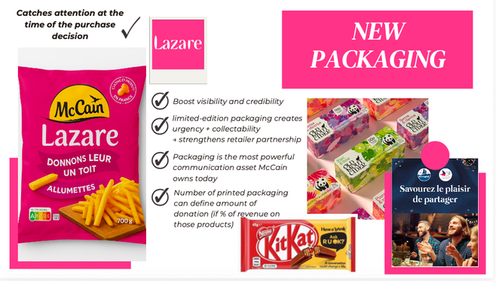
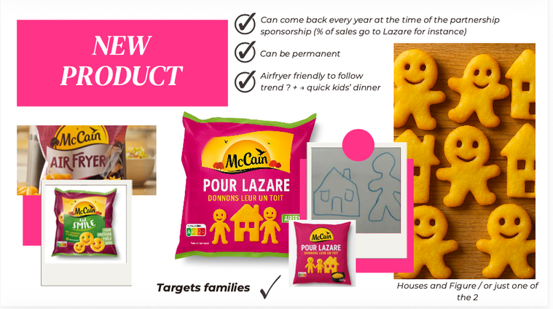
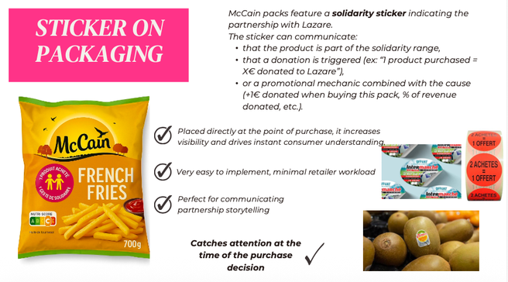
MASS MARKET REACH
Product-Sharing & Packaging (“Produit-partage”)
NEW PACKAGING
NEW PRODUCT
STICKER ON PACKAGING
McCain × Lazare × CNPB Consulting Project 2026

Slide 17
MASS MARKET REACH
POS / PLV Materials
What it is:
Visibility KPIs
% of stores displaying all POS materials (compliance).
Number of POS elements installed.
Place co-branded in-store materials:
Shelf cards
Freezer-door stickers
Floor decals
Wobblers
Endcap displays
Awareness KPIs
% of shoppers who noticed the POS materials.
Recall of the message (“What was McCain promoting in-store?”)
Variation in sales.
Communicate the donation clearly and visually.
McCain × Lazare × CNPB Consulting Project 2026

Slide 18
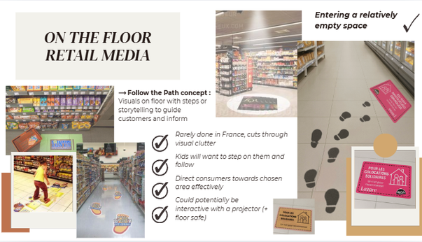
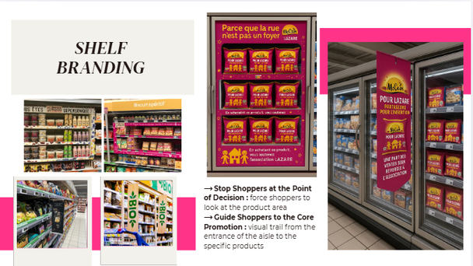
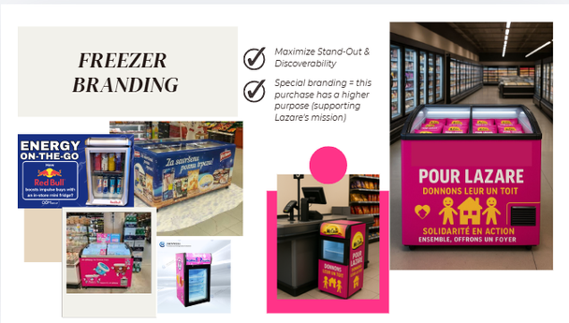
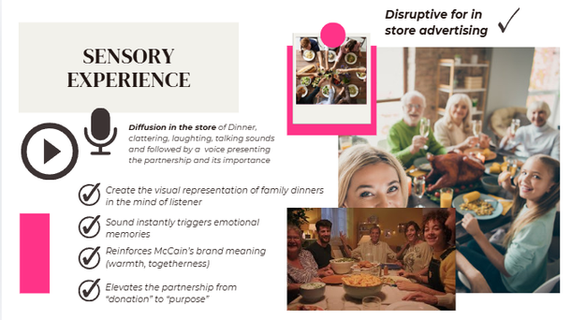
MASS MARKET REACH
POS / PLV Materials
ON THE FLOOR
RETAIL MEDIA
FREEZER
BRANDING
SHELF
BRANDING
SOUND DIFFUSION
McCain × Lazare × CNPB Consulting Project 2026

Slide 19
MASS MARKET REACH
Digital Media & Flyers
What it is:
Visibility KPIs
Use retailer communication channels to highlight the partnership.
Include the program in store leaflets, newsletters, digital screens, banner ads, frozen-aisle TVs, etc.
Share short branded video snippets explaining Lazare’s mission.
Add QR-enabled flyers directing shoppers to Lazare’s story.
Total impressions (newsletter + banners + digital screens).
Newsletter open rate & click-through rate.
Flyer circulation quantity.
QR scan rate from printed flyers.
Awareness KPIs
% recalling the donation mechanic.
Number of clicks, likes, engagement.
Variation in sales.
Enhance Credibility & Trust
McCain × Lazare × CNPB Consulting Project 2026

Slide 20
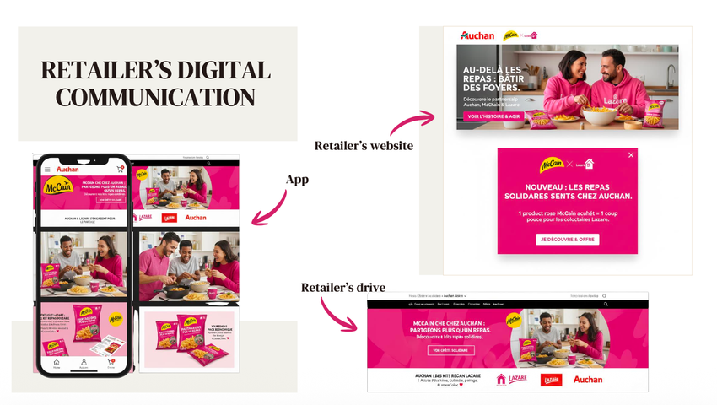
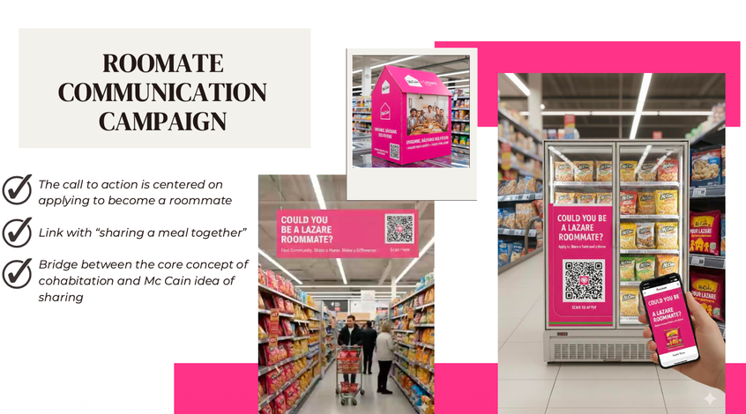
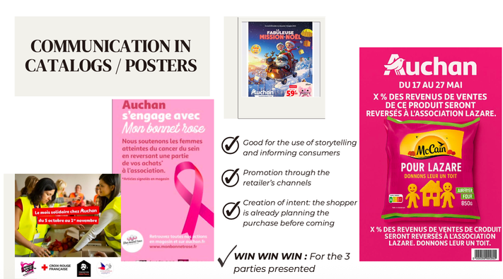
MASS MARKET REACH
Digital Media & Flyers
RETAILER DIGITAL COMMUNICATION
ROOMATE COMMUNICATION CAMPAIGN
COMMUNICATION IN POSTERS
McCain × Lazare × CNPB Consulting Project 2026

Slide 21
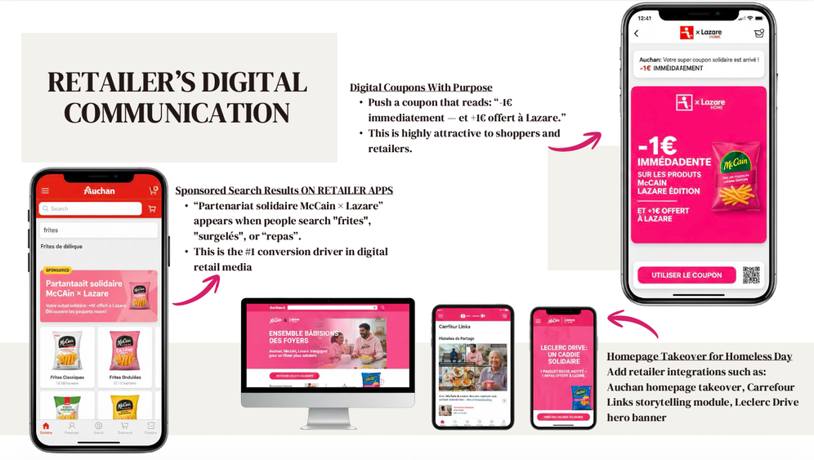
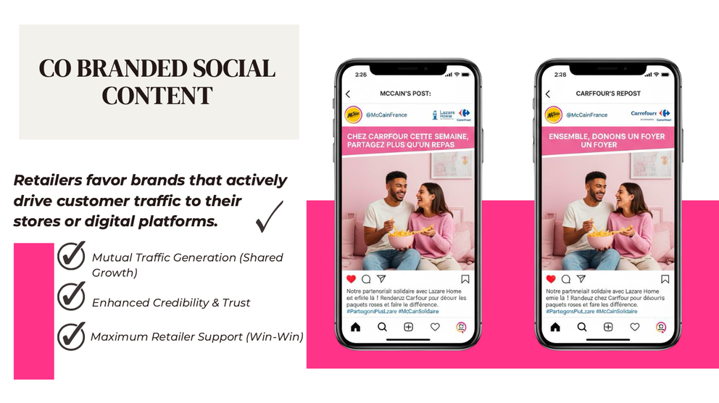
MASS MARKET REACH
Digital Media & Flyers
RETAILER DIGITAL COMMUNICATION
CO BRANDED SOCIAL CONTENT
McCain × Lazare × CNPB Consulting Project 2026

Slide 22
McCain × Lazare
Inside a Retail Environment
High-Involvement Experiences (Deep Emotional Connection)
McCain × Lazare × CNPB Consulting Project 2026

Slide 23
DEEP EMOTIONAL CONNECTION
Visibility KPIs
Donation Mechanic
Number of shoppers exposed at checkout.
Number of receipts carrying Lazare messaging.
What it is:
Introduce donation prompts directly at checkout:
Round-up donations
Add-on micro-donations (+0,50€)
Some retailers can add matched donations upon meeting targets.
% of revenues of chosen product and period go to Lazare
Awareness KPIs
% aware of the donation option.
Recall of “round-up” or “+0,50€” messaging.
Additional KPIs
Total € donated via checkout.
Opt-in rate (% of shoppers contributing).
Variation in sales
Much larger impact than a one-time corporate donation, engages shoppers by making them part of the impact
McCain × Lazare × CNPB Consulting Project 2026

Slide 24
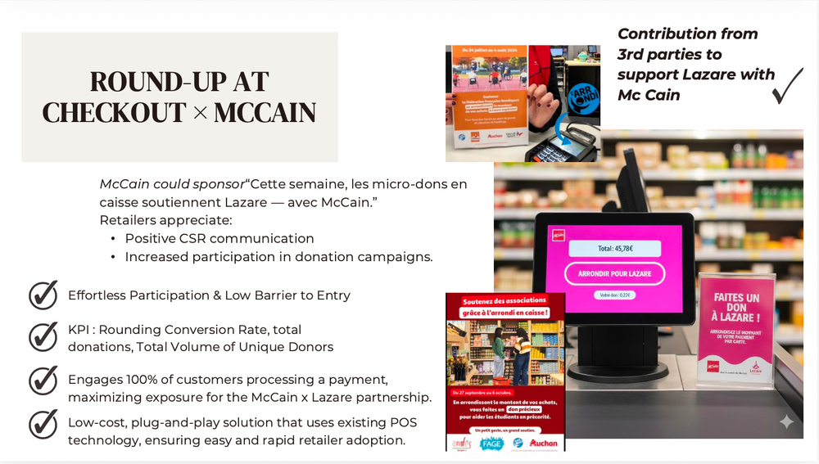
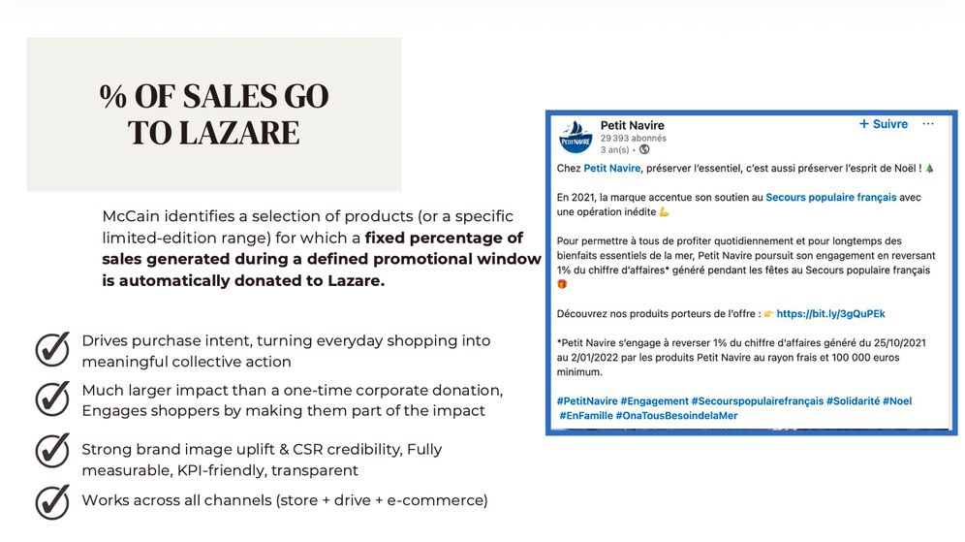
DEEP EMOTIONAL CONNECTION
Donation Mechanic
ROUND-UP AT CHECKOUT
% OF SALES GO TO LAZARE
McCain × Lazare × CNPB Consulting Project 2026

Slide 25
DEEP EMOTIONAL CONNECTION
In-Store Cause Sampling Events
Visibility KPIs
What it is:
Number of samples distributed.
Volunteer hours logged.
Host “Lazare Story” sampling corners in major retailers (Auchan).
Provide free hot fries while McCain staff and Lazare residents volunteer together.
Have Lazare rommates storytell and call for action .
Awareness KPIs
% of participants who can explain Lazare’s mission after visiting.
Additional KPIs
Encourage social sharing though human connection and consumer empathy.
Social impressions from event photos and videos.
Retailer manager evaluation of event quality.
McCain × Lazare × CNPB Consulting Project 2026

Slide 26
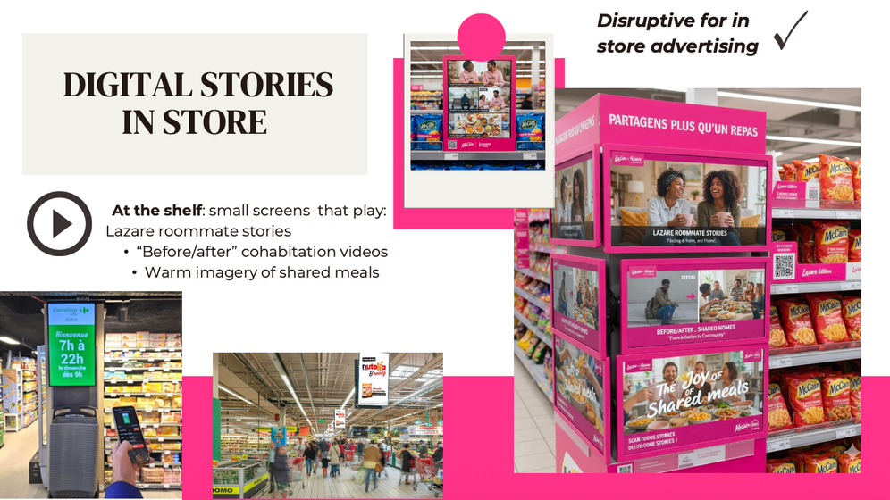
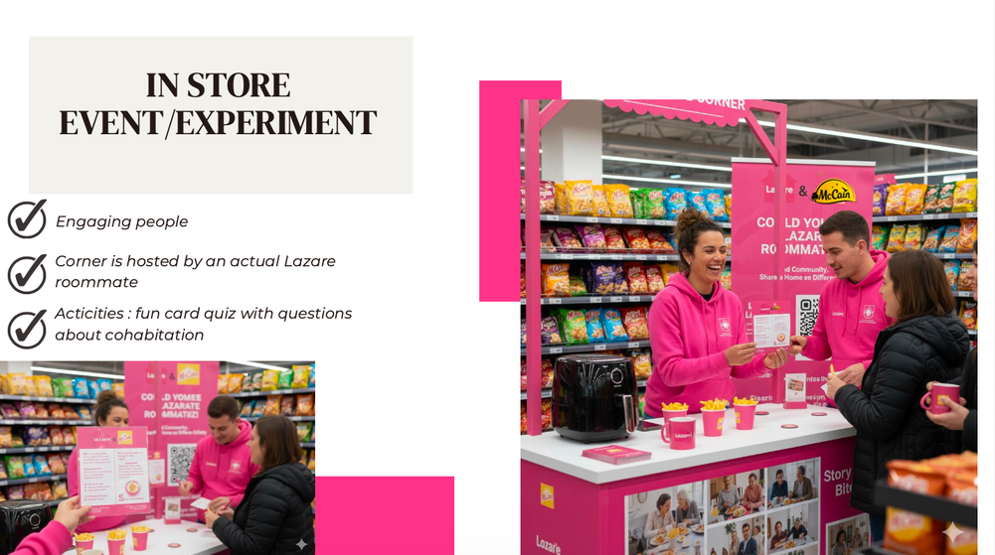
DEEP EMOTIONAL CONNECTION
In-Store Cause Sampling Events
DIGITAL STORIES IN STORE
IN STORE EVENT/EXPERIMENT
McCain × Lazare × CNPB Consulting Project 2026

Slide 27
DEEP EMOTIONAL CONNECTION
Disruptive In-Store Interaction
Visibility KPIs
What it is:
Number of time the button has been pressed.
Corelation between sales and press of button.
Variation in sales
Number of drawings gathered
Hidden tickets inside packs trigger experiential rewards or direct donations when scanned
A disruptive in-aisle installation where pressing a button triggers a 0.10€ donation from McCain
Family-focused engagement where uploaded children's drawings of "shared meals" trigger donations, creating vast User Generated Content (UGC).
Awareness KPIs
% of participants
Approval rates
Driving engagement and shareability throught gamification.
McCain × Lazare × CNPB Consulting Project 2026

Slide 28
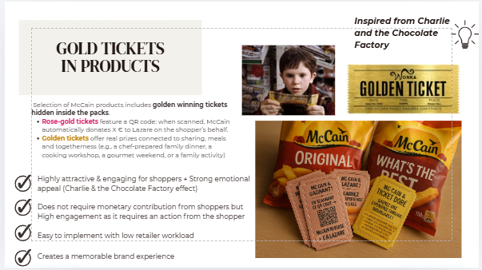
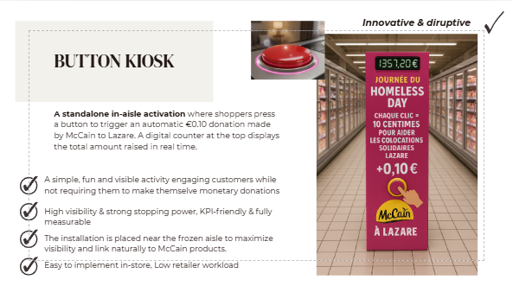
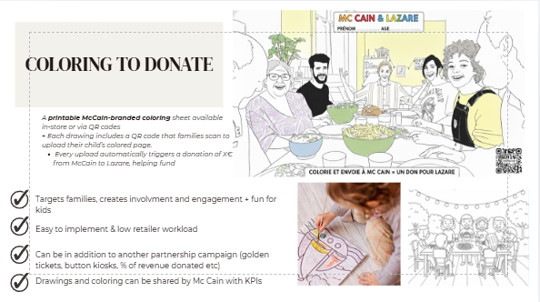
DEEP EMOTIONAL CONNECTION
Disruptive In-Store Interaction
GOLD TICKETS
BUTTON KIOSK
COLORING TO DONATE
McCain × Lazare × CNPB Consulting Project 2026

Slide 29
3 -YEAR IMPLEMENTATION PLAN
03
Scale Success
02
Retail DNA Integration
Launch long-term product innovations aligned with Lazare.
Transition McCain fully from functional to emotional equity.
Establish the partnership as a permanent retail standard.
01
Scale the "Global Concept" across regional hypermarkets.
Refine tripartite communication (McCain x Auchan x Lazare).
Formalize the "CSR Halo" for the retailer to attract families.
Plug & Play Activation
Launch high-visibility POS/PLV materials in Auchan.
Implement commercial mechanics to replace cash donations.
Pilot "Born to Share" themed in-store events.
18-36 months
6-18 months
0-6 months
McCain × Lazare × CNPB Consulting Project 2026

Slide 30




Key Takeaways
From Donations to Strategic Co-Creation
Win-Win-Win Model
Retail-First Strategy
A tripartite partnership where McCain, Lazare, and Auchan each gain clear, measurable value.
Shifting from isolated charity events to embedded, visible in-store activations at the point of purchase.
Emotional Brand Equity
Modular Vision Board
Moving McCain from functional product positioning to purpose-driven storytelling through "Born to Share."
A flexible toolkit of scalable concepts, ready to adapt to the direction of retailer negotiations.
The partnership is no longer about writing a cheque, it's about building something together.
EDHEC Business School - 2025/2026

Slide 31










Slide 32
Appendices

Slide 33
Sources
___________
BENCHMARKING
Benchmarking_McCain Lazare
ISSUE TREE
Issue Tree

Slide 34
Benchmarking - Deliverable
Link to the above slide

Slide 35
MoodBoard - Deliverable
Link to the above slide

